Slide 1



AI Call Center Agent

Slide 2
AI Call Center Agent
Muhammed Hussein Aly Ali Mahmoud Ali Mayada Gamal Ali Youssef Waleed Ibrahim Omar Ali Omar Omar Osama Mohamed Supervised By Dr. Mohamed Safy Moussa Elwan

Slide 3
Table of contents
Problem Statement
Solutions
Models
Results
Workflows
Diagrams
Future Work

Slide 4
Problem Statement
Traditional call centers struggle with operational inefficiencies.
Long wait times frustrate customers and diminish satisfaction.
Inconsistent service experiences erode trust and loyalty.
Manual handling of inquiries leads to errors and delays.
Limited scalability hampers adaptability to fluctuating demand.
Resource constraints restrict the capacity to meet customer needs effectively.

Slide 5
Solution
AI-powered virtual agents streamline call center operations and enhance customer interactions.
Automated handling of routine inquiries through chatbots reduces wait times and frees up human agents.

Slide 6
Brain Storming

Slide 7
Llama

Slide 8
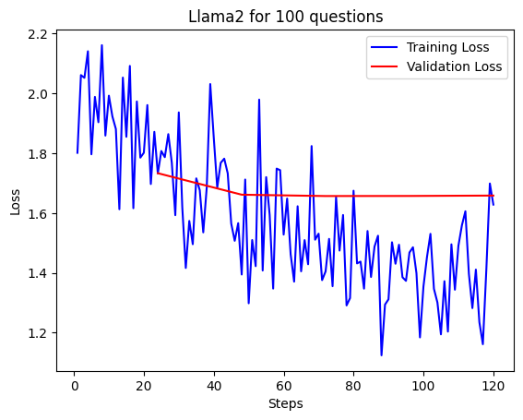

Slide 9
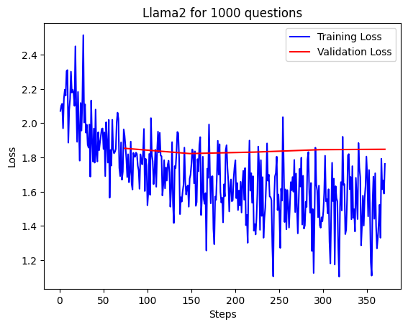

Slide 10
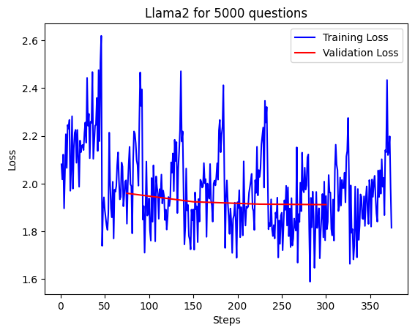

Slide 11
BERT

Slide 12
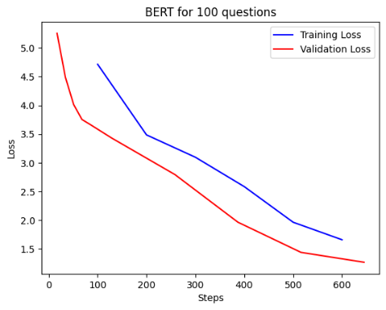

Slide 13
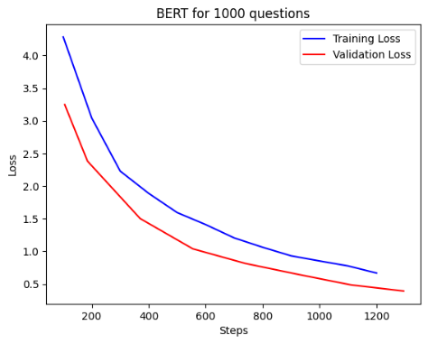

Slide 14
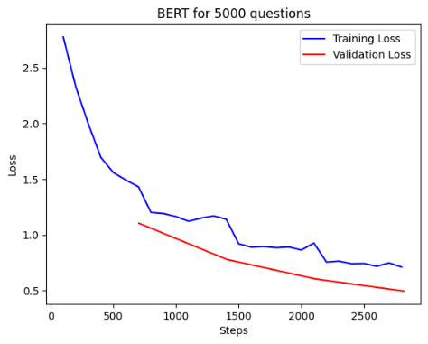

Slide 15
T5

Slide 16
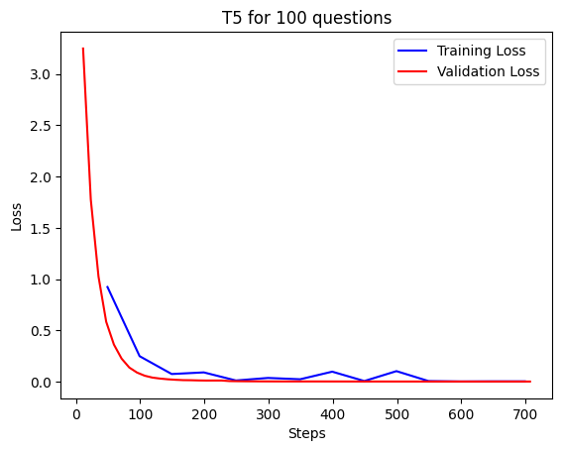

Slide 17
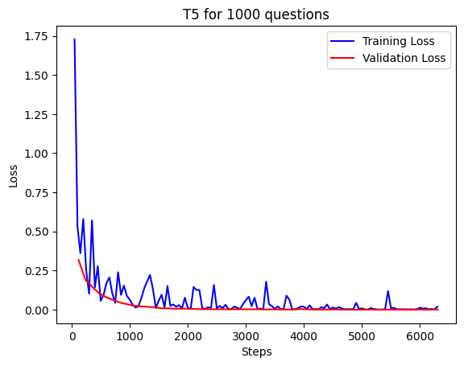

Slide 18
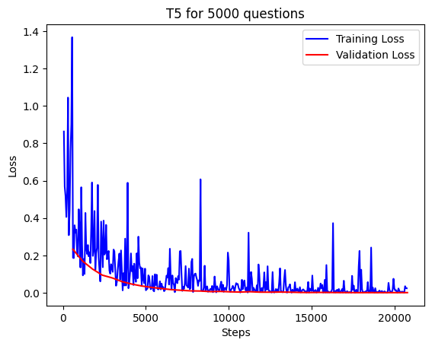

Slide 19
Results

Slide 20
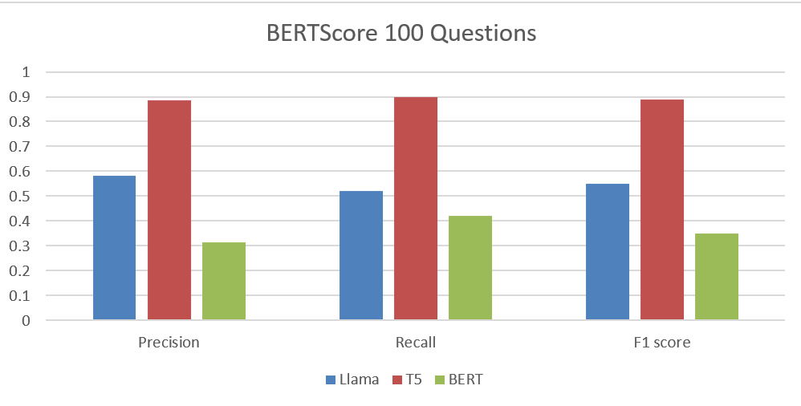

Slide 21
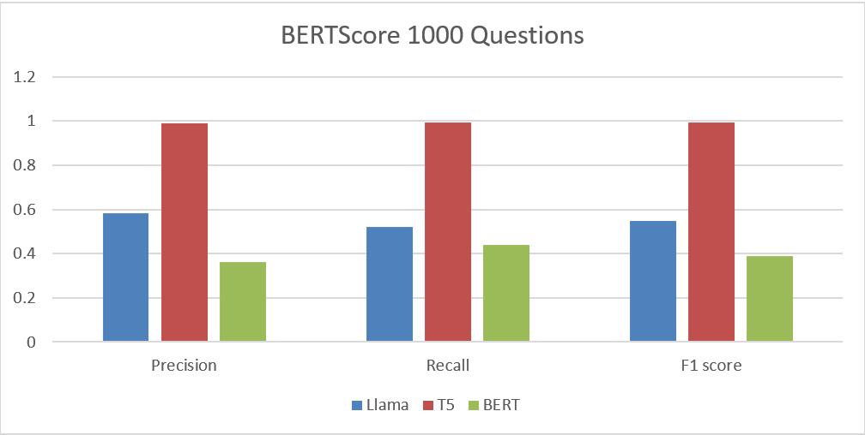

Slide 22
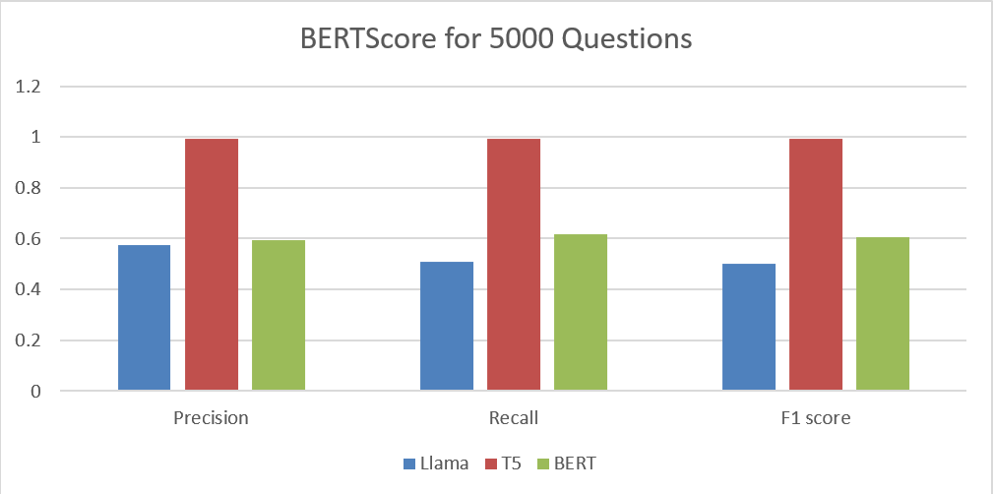

Slide 23
Workflow

Slide 24
S2T

Slide 25
S2T
T5

Slide 26
Workflow
Conversational
Model
S2T
T5

Slide 27
Workflow
Conversational
Model
S2T
T2S
T5

Slide 28
Diagrams

Slide 29
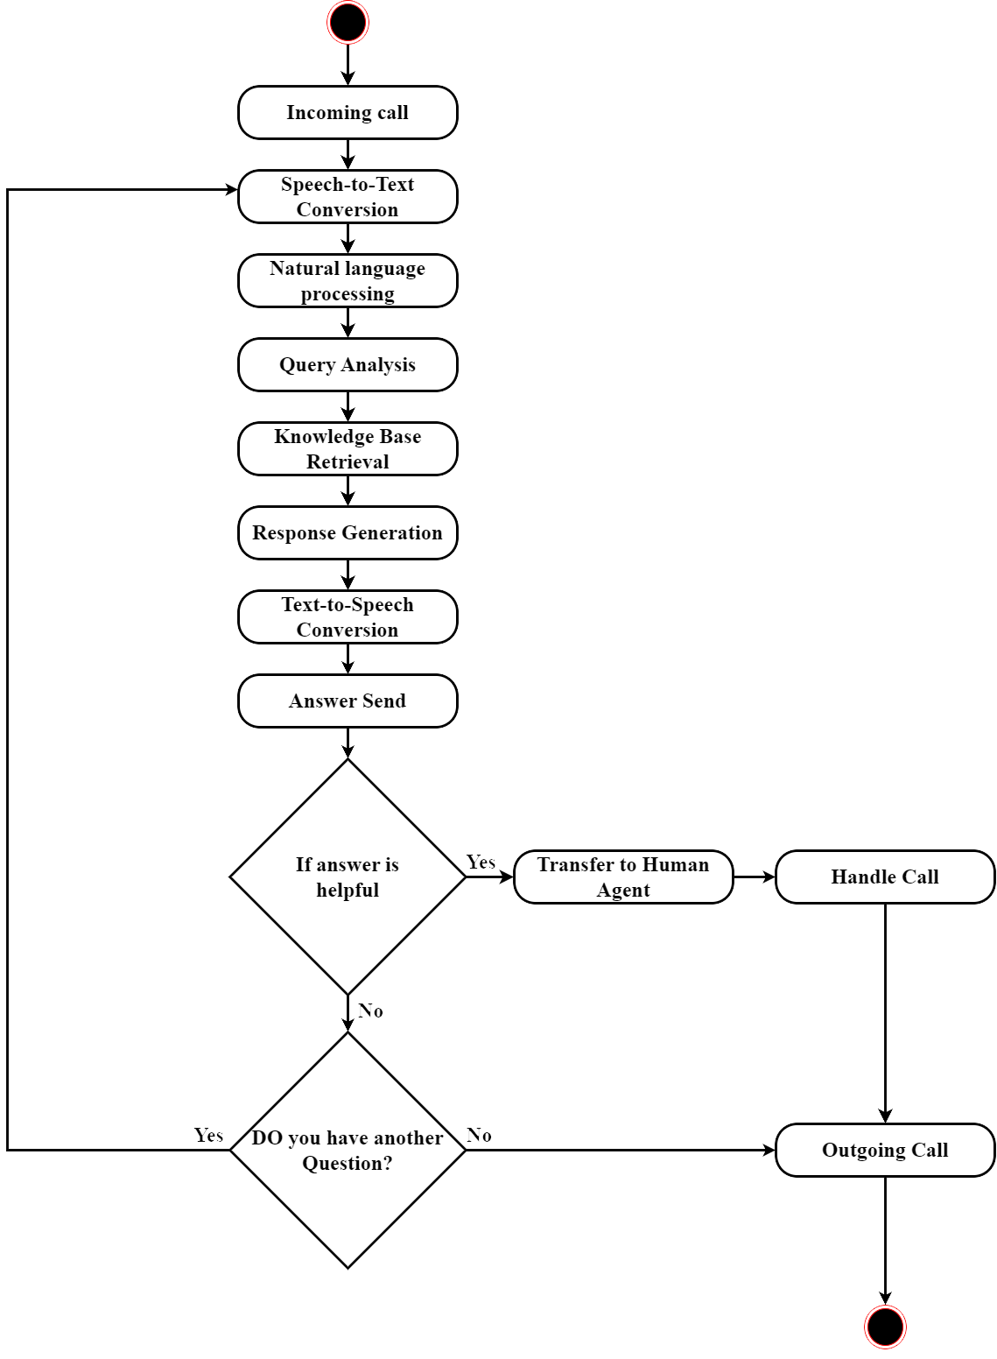

Slide 30
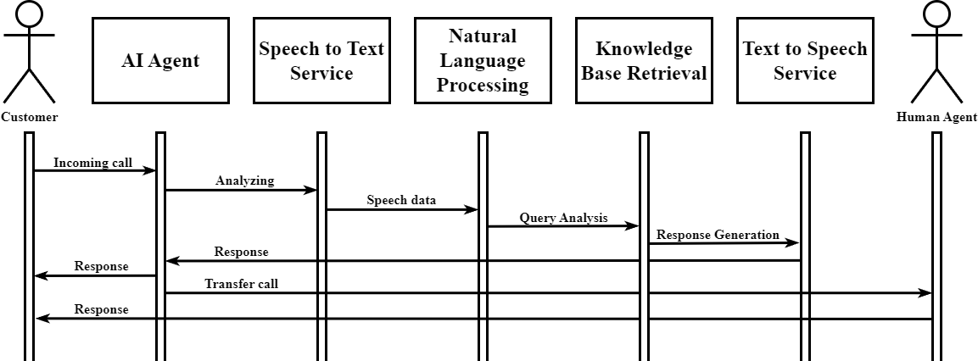

Slide 31
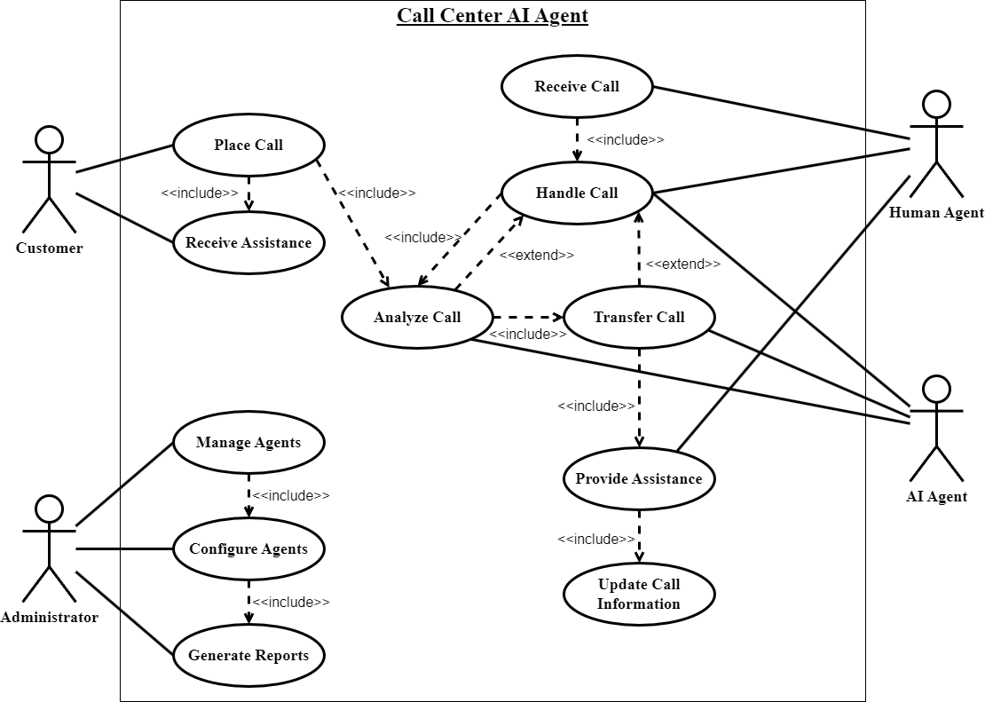

Slide 32
Future work

Slide 33
Prototype

Slide 34
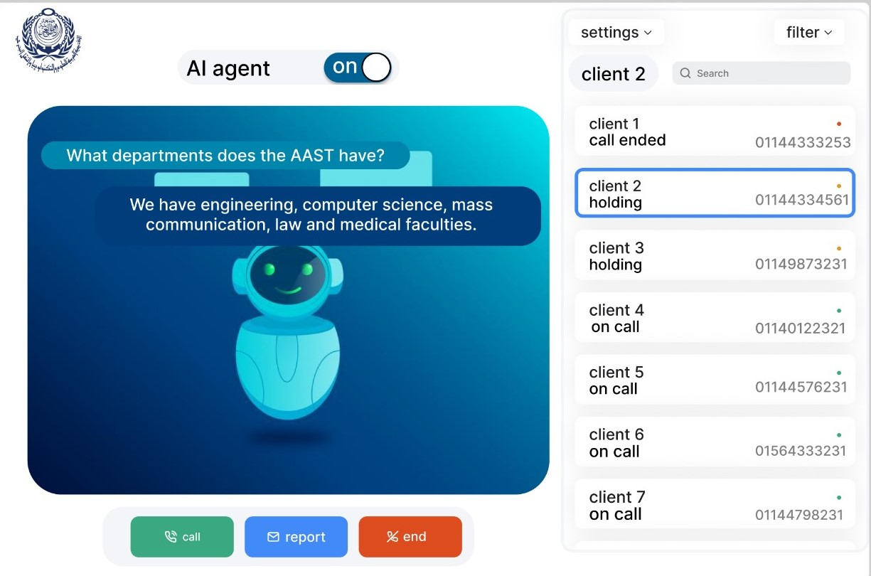

Slide 35
Questions?

Slide 36
Thank you

